Slide 1
Finding Optimal Price Point for Big Mountain Resort Tickets

Slide 2
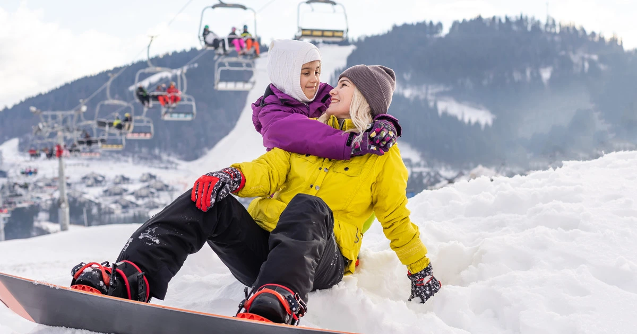
Balancing interests. Bring joy and connection by identifying valued features and treating them as they are worth.

Slide 3
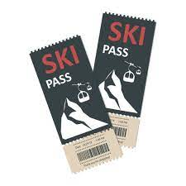
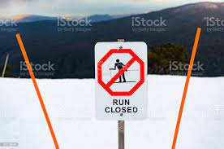
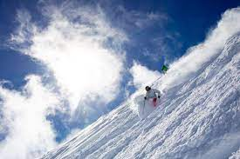
Recommendation
It is recommended that big mountain increase ticket price to $95, and keep all except one run open as closing more than one run undermines ticket price. It would be appropriate to run in this manner for a season then reassess close another run if ticket prices stay consistent when continuing to drop one run per season. It is also recommended that they increase the vertical drop as long as doing so does not cost more than the year/over year profit it will bring. Price could be increased to almost $97 if these implementations are made.
Notes:
Through comparaitive analysis, Big Mountain consistently performs at the high end of distributions in top-earning features such as vertical drop, total chairs, snow making area, fast quads and runs.
Currently, Big Mountain charges 81.00 dollars per ticket for their resort. According to the model that price should be at 94.22 dollars, a difference of 13.22 dollars per ticket. Even with a mean standard error of 10.39 that still leaves room to increase ticket price.
The model says closing one run makes no difference. Closing 2 and 3 successively reduces support for ticket price and so revenue. If Big Mountain closes down 3 runs, it seems they may as well close down 4 or 5 as there's no further loss in ticket price. Increasing the closures down to 6 or more leads to a large drop.
Thus, it is recommended that big mountain keep all runs open, as closing runs undermines ticket price, and increase the vertical drop as long as doing so does not cost more than the year/over year profit it will bring.
Thus, it is recommended that big mountain increase ticket price to $95, and keep all except one run open as closing more than one run undermines ticket price. It would be appropriate to run in this manner for a season then reassess close another run if ticket prices stay consistent when continuing to drop one run per season. It is also recommended that they increase the vertical drop as long as doing so does not cost more than the year/over year profit it will bring.

Slide 4
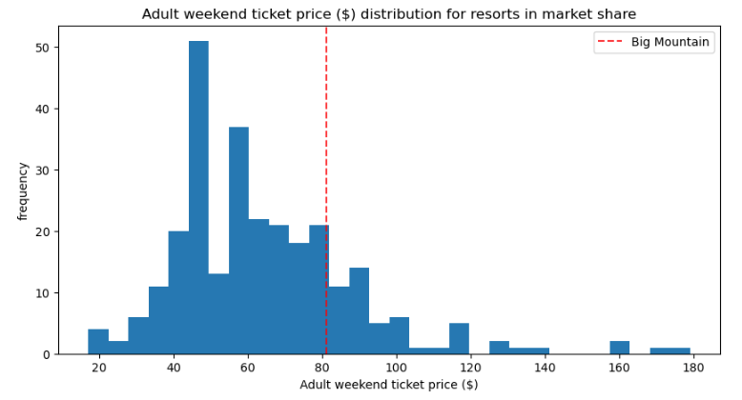
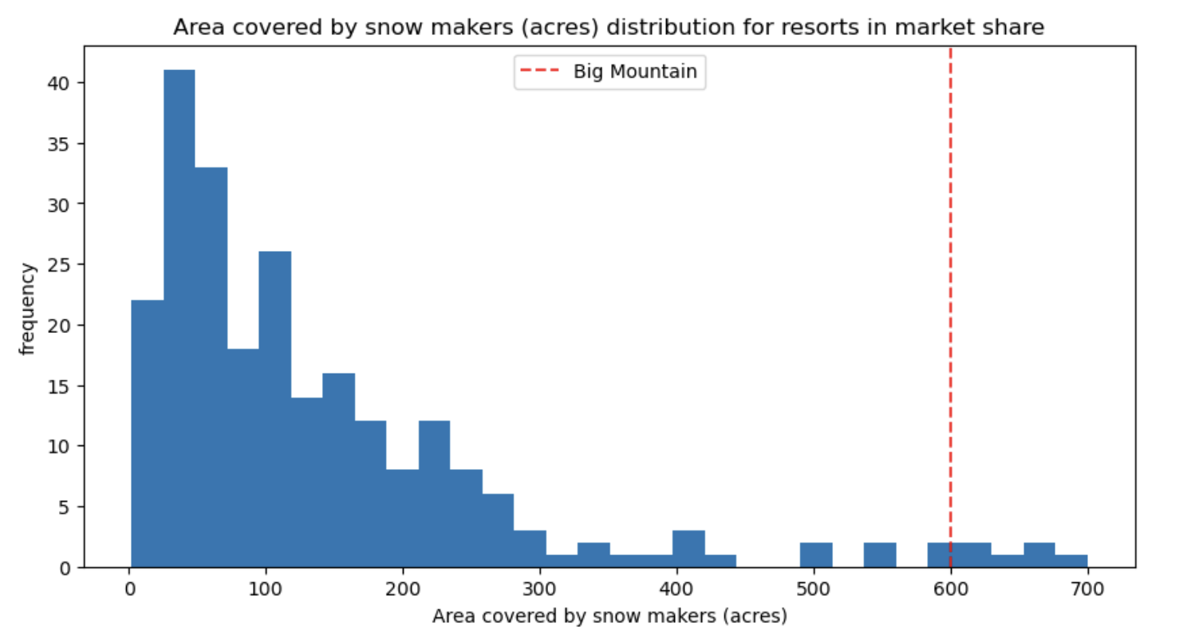
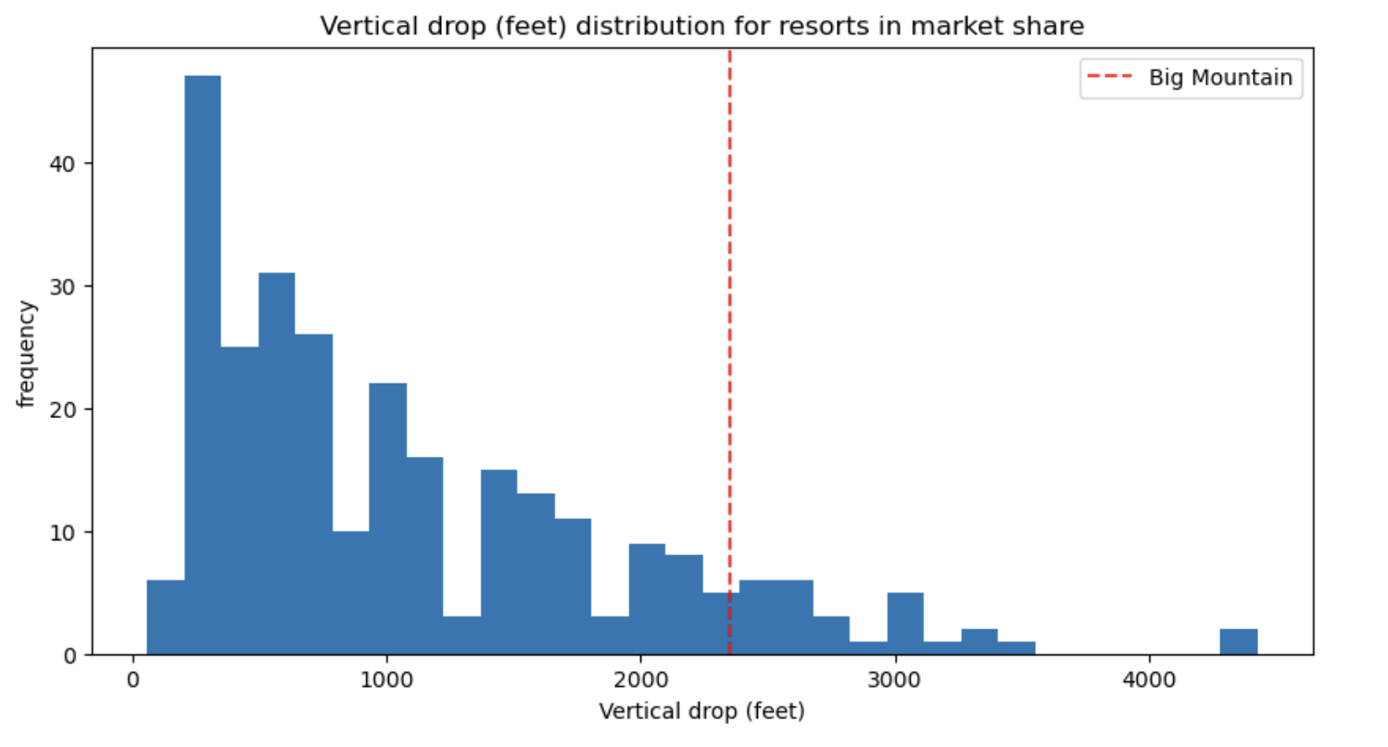
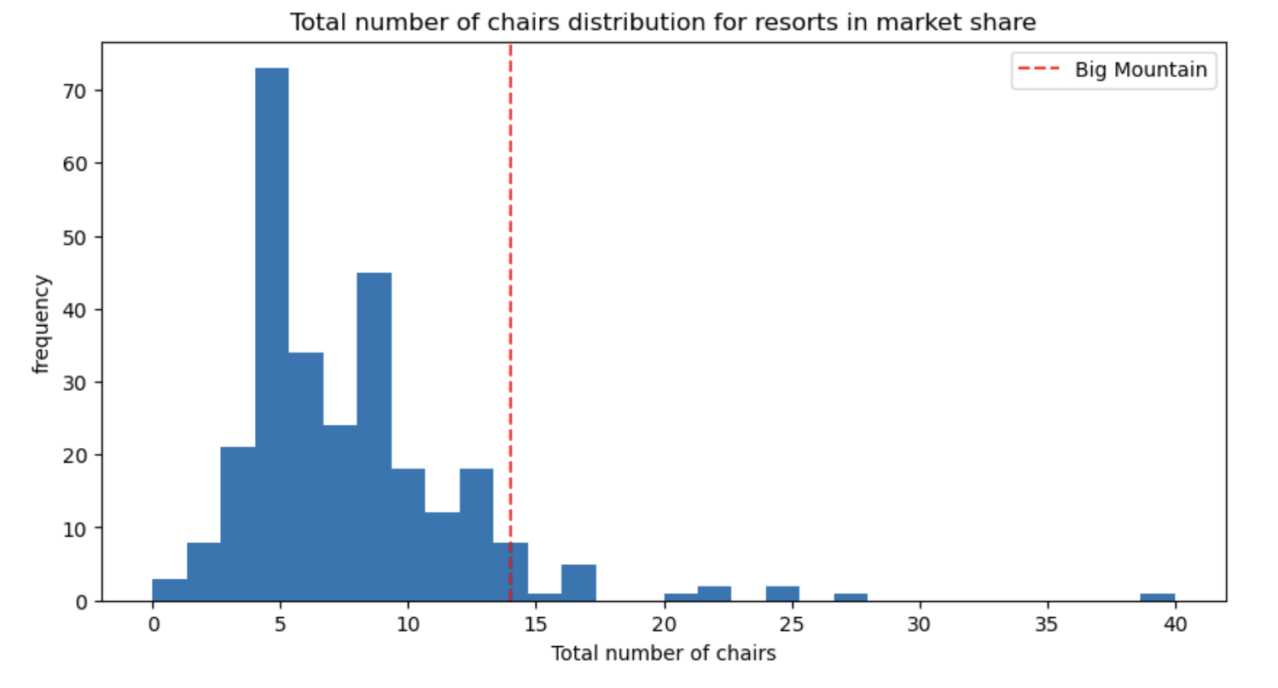
Big Mountain Resort’s modelled price is $95.87, actual price is $81.00.
Even with the expected mean absolute error of $10.39, this suggests there is room for an increase.
Notes:
If time would make these into histogram overlays to visualize all in one graph. Visualize big mountain place in the market share. A top runner in all of the top earning features. Based on model, Big Mountain Resort modelled price is $95.87, actual price is $81.00.
Even with the expected mean absolute error of $10.39, this suggests there is room for an increase.

Slide 5
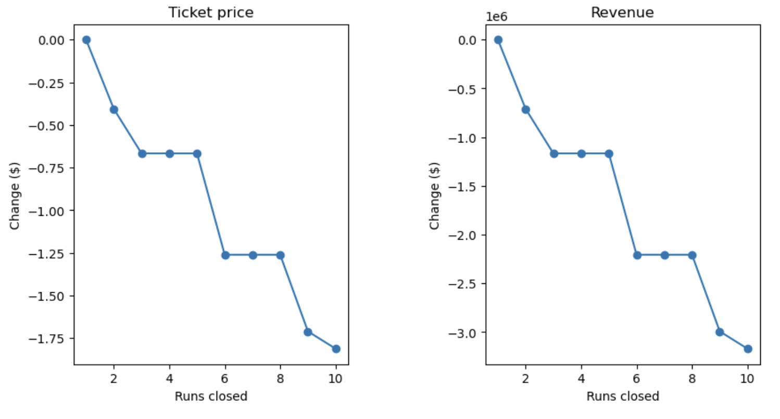
Scenario 1: Closing a run

Slide 6
Scenario 2 & 3
In this scenario, Big Mountain is adding a run, increasing the vertical drop by 150 feet, and installing an additional chair lift.
The model predicts that this scenario increases support for ticket price by $1.99. Over the season, this could be expected to amount to $3474638
In this scenario, you are repeating the previous one but adding 2 acres of snow making.
The model does not demonstrate an increase in ticket price based on an increase of 2 acres of snow making.

Slide 7
Scenario 3 & 4
In the third scenario, you are repeating scenario two but adding 2 acres of snow making. The fourth scenario calls for increasing the longest run by .2 miles and guaranteeing its snow coverage by adding 4 acres of snow making capability.
No change in ticket price denoted.

Slide 8
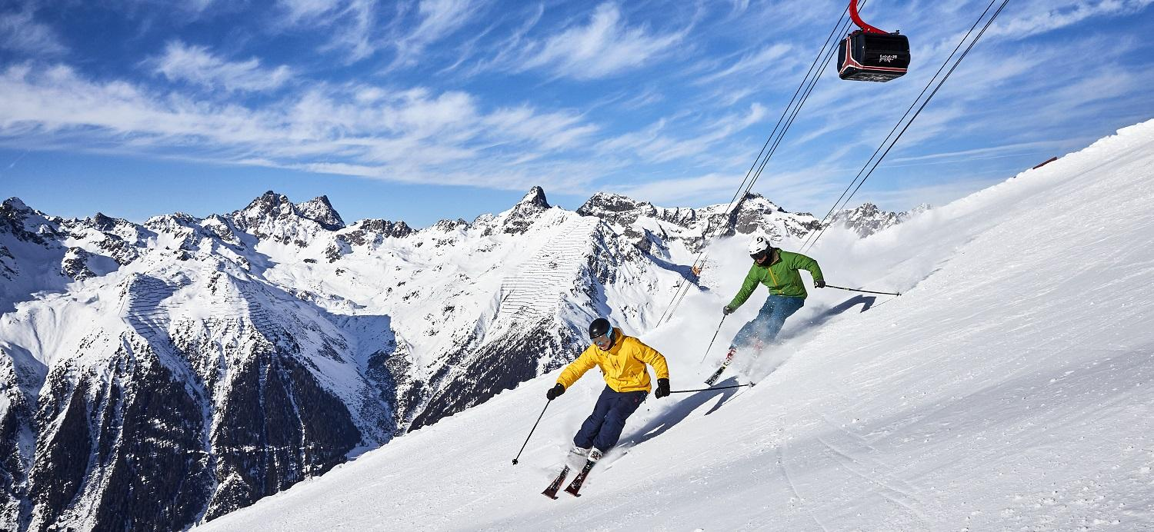
Summary
it is recommended that big mountain increase ticket price to $95, and keep all except one run open as closing more than one run undermines ticket price. It would be appropriate to run in this manner for a season then reassess close another run if ticket prices stay consistent when continuing to drop one run per season. It is also recommended that they increase the vertical drop as long as doing so does not cost more than the year/over year profit it will bring.

